Slide 1

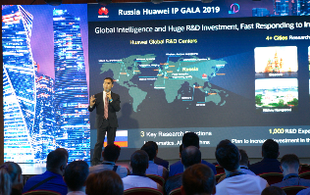
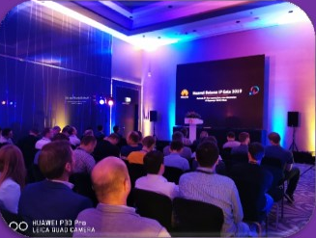
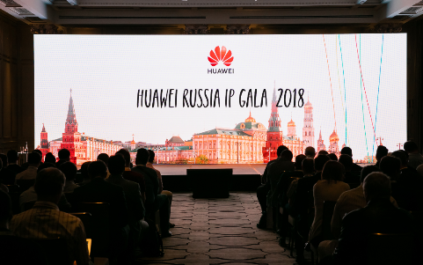
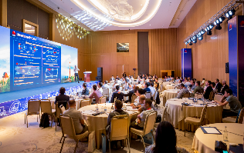
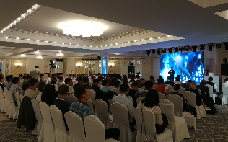
Huawei IP GALA 3.0 is Coming!
IP GALA 3.0
Participants: ~800
IP GALA 2.0
Participants: 500+
Eurasia
11 countries
Russia @ Moscow
Belarus @ Minsk
IP GALA 1.0
Participants: 150+
Russia @ Moscow
Uzbekistan @ Tashkent
Kazakhstan @ Almaty
2018
2019
2020

Slide 2
Huawei IP GALA Background
“Goal of Huawei IP GALA is to create a platform for successful communications between industry, carriers, and experts. The summit is to promote the industry trend, new technology and successful commercial experience to all industry members and the sustainable development of the ecosystem. ”
Time: 18.09.2020, 09:00~13:00 (Moscow Time).
Slogan: In the F5G Era, Intelligent IP Builds Intelligent Connections for 5G & Cloud Services.
Content: Industry trend and standard, new technology and solution, successful commercial experience, etc.
Participants: Standard organization, Carriers, industry expert etc.
Mode: On line: All of the participants.
Off line: Keynote speech speakers at Huawei CSIC (Крылатская ул., 17к4, Москва).
Looking forward to seeing you at the Third Russia IP GALA summit!

Slide 3
Agenda
Category | Add. | Time | Duration | Topic
Keynote Speeches | Live Broadcast + Moscow CSIC | 08:55~09:00 | 5 mins | Open Video
 |  | 09:00~09:10 | 10 mins | Welcome Speech - Huawei
 |  | 09:10~09:30 | 20 mins | Leading Intelligent IP networks - Huawei
 |  | 09:30~09:50 | 20 mins | Transport Network KAI Standard in F5G Era – Consultant
 |  | 09:50~10:10 | 20 mins | IP Metro Network Strategy for Cloud and 5G era - Operator
 |  | 10:10~10:30 | 20 mins | FMC Best Practice - Moscow Network Convergence - Operator
 |  | 10:30~10:40 | 10 mins | Coffee Break
 |  | 10:40~11:00 | 20 mins | Eurasia IP Industry Trend Analysis in F5G Era - Consultant
 |  | 11:00~11:20 | 20 mins | Full-Lifecycle Intelligent O&M - Operator
 |  | 11:20~11:40 | 20 mins | IP Mobile Backhaul Network Strategy for 5G - Operator
 |  | 11:40~12:00 | 20 mins | Next Generation Intelligent IP Network Base on SDN - Operator
 |  | 12:00~12:10 | 10 mins | Coffee Break
Demonstration |  | 12:10~12:40 | 30 mins | Target IP Network 2025 Evolution - Huawei
 |  | 12:40~13:00 | 20 mins | Demonstration for Intelligent IP Solutions - Huawei
Dear_____________,
We cordially invite you to attend the Third Eurasia IP GALA Summit (Live Broadcast), which will be held on September 18th, 2020.
Our goal is to create a platform for successful communications between industry, carriers, and experts. The summit is to promote the industry trend, new technology and successful commercial experience to all industry members and the sustainable development of the ecosystem.
An intelligent era is fast approaching. The entire ICT sector will face tremendous opportunities and challenges. As a result, the industry chain has already shifted its focus and started exploring how to empower intelligent transformation through innovation technologies and to maximize business value, intelligent IP network plays much more important role, which change network from the Best Effort-like to SLA guaranteed.
First-class quality networks create new opportunities. Let us embrace these opportunities together to create a promising digital future for the benefit of all humanity.
Looking forward to seeing you at the Third Russia IP GALA summit!
Huawei Eurasia

